Slide 1
PHONEPE TRANSACTION INSIGHTS
MINI PROJECT - 1
BY PASUPATHI RAJ M

Slide 2
Project work flow
Data Extraction
Cloned and extracted Phone Pe Pulse data from the official GitHub repository.
Data Transformation
Parsed JSON files and converted them into structured formats (like Data Frames).
Data Storage
Stored the transformed data into a relational database (MySQL).
Data Analysis
Analysed transaction trends, categories, states, districts, and more.
Created graphs, charts, or summaries for better understanding using Streamlit

Slide 3
Introduction
Case 1: Decoding Transaction Dynamics
Case 2: Device Dominance & Engagement
Case 3: Insurance Penetration & Growth
Case 4: Market Expansion Strategy
Case 5: User Engagement and Growth Strategy

Slide 4
Introduction
Phone Pe is one of India’s leading digital payment platforms, enabling users to make secure and convenient financial transactions .
This project aims to explore and analyse transaction data from Phone Pe across various states and categories, providing insights into usage patterns, transaction volumes, and regional trends.
Through this project, we seek to highlight key trends, visualize data, and draw meaningful conclusions from Phone Pe transaction records.

Slide 5
Business Use Case 1: Decoding Transaction Dynamics
Objective
Analyse transaction patterns across states, quarters, and categories.
Identify growth, stagnation, or decline trends.

Slide 6
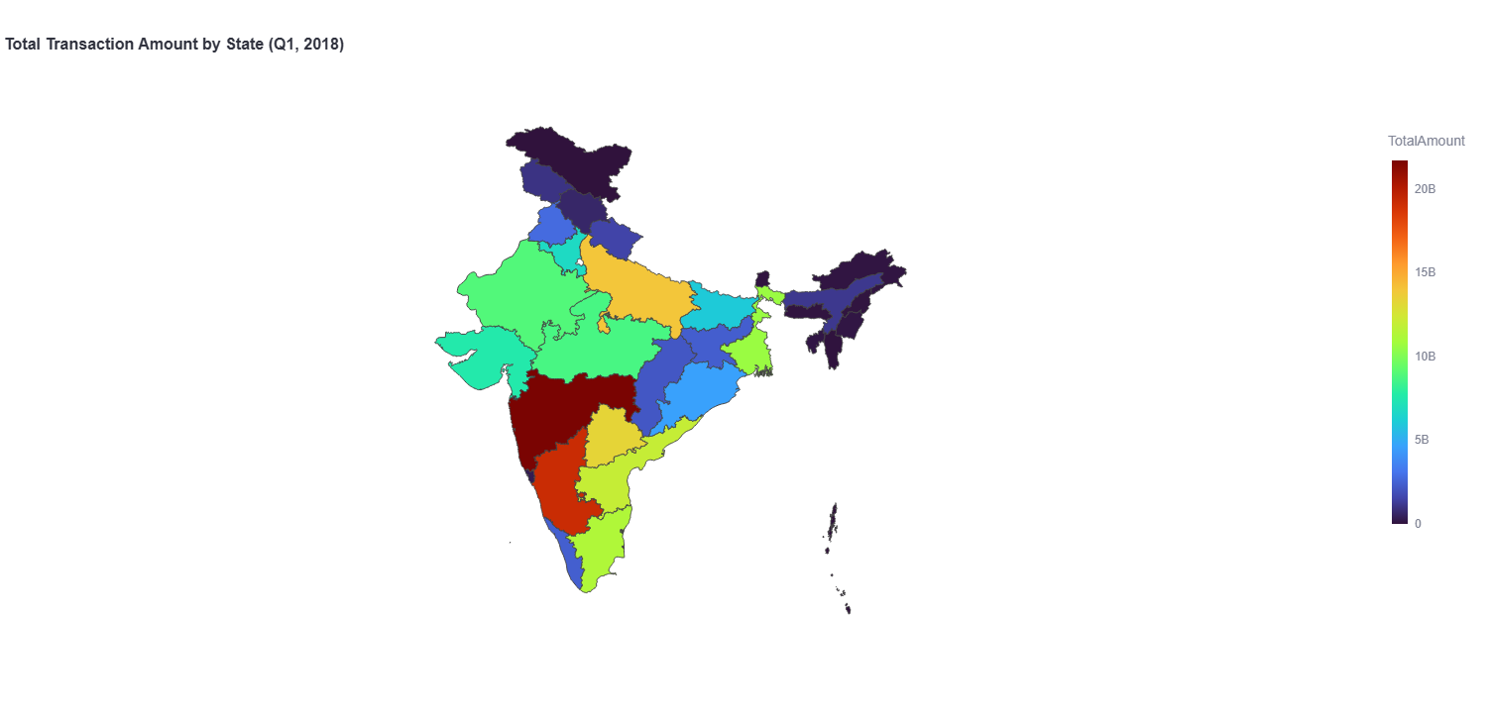
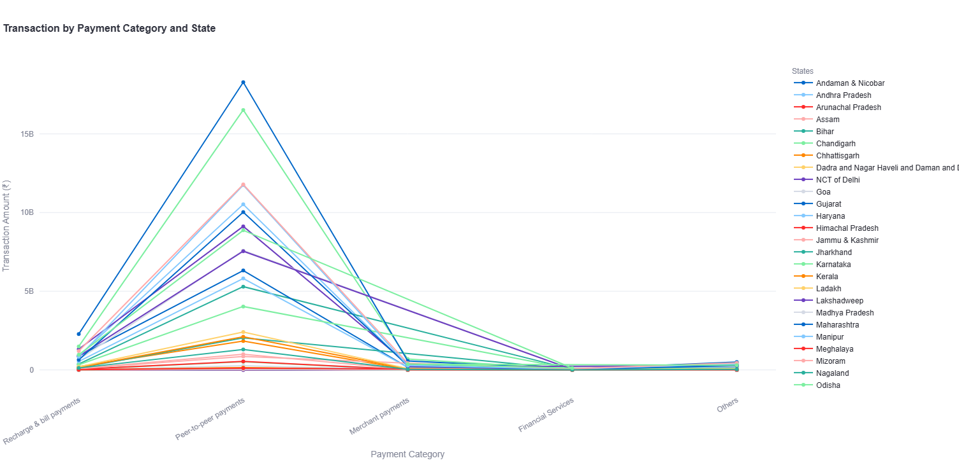
Visualisation
Total Transaction Amount Trend by State
Total Transaction Amount Trend by Transaction type

Slide 7
Case 2: Device Dominance and Engagement
Objective
Understand app usage behaviour by device brand and region.

Slide 8
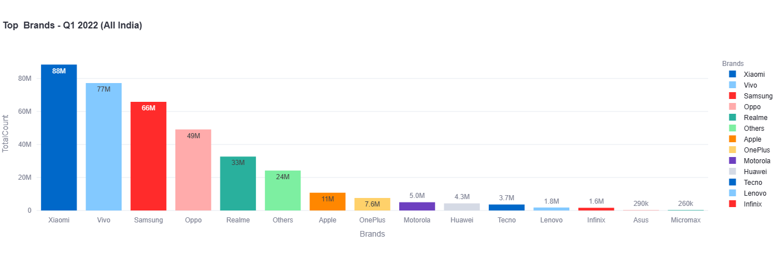
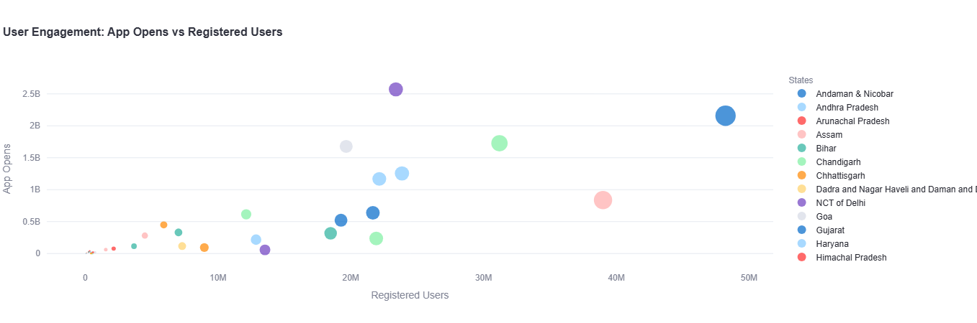
Visualisation
Device Brands by Total Users
App Opens vs Registered Users

Slide 9
Case 3: Insurance Penetration Analysis
Objective
Assess adoption of insurance products and identify growth opportunities.

Slide 10
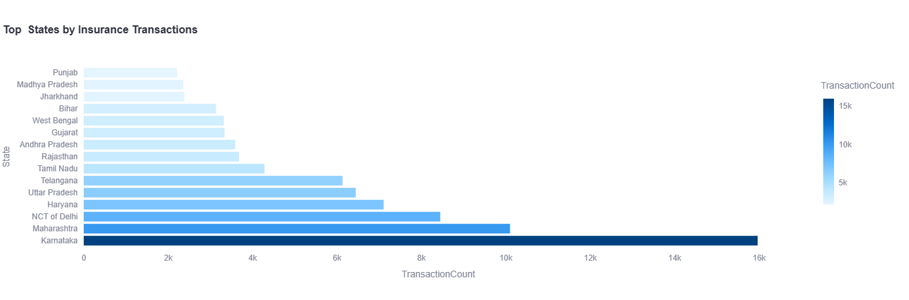
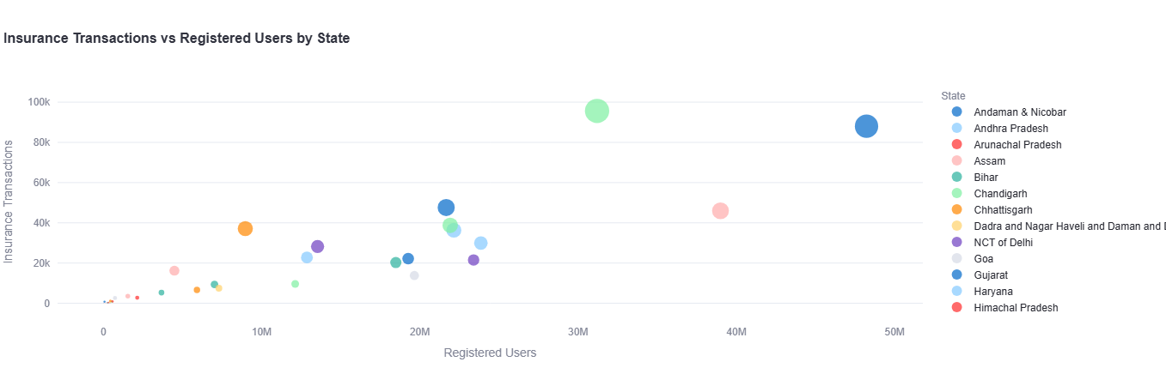
Visualisation
Top States by Insurance Adoption
Insurance vs User Penetration Ratio

Slide 11
Case 4: Market Expansion Strategy
Objective
Analyse transaction trends to guide regional expansion

Slide 12
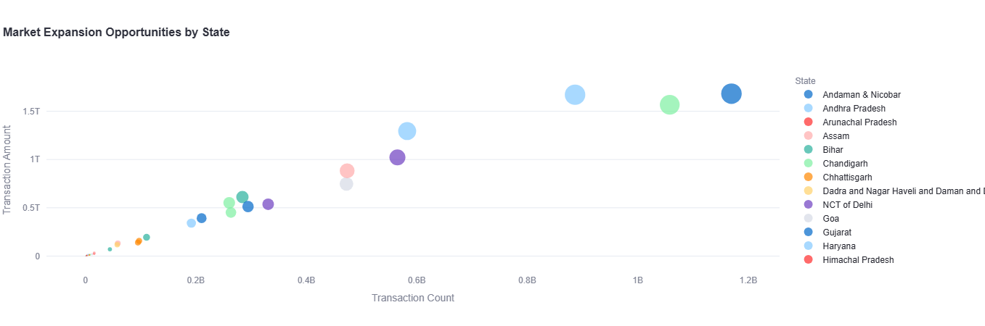
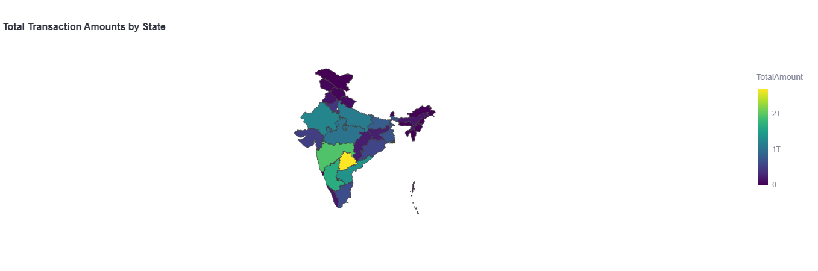
Visualisation
Market Size vs Frequency (by State)
Market Coverage by State (Transaction Amount)

Slide 13
Case 5: User Engagement and Growth Strategy
Objective
Increase user retention, boost active usage, and drive user base expansion through targeted strategies and initiatives.

Slide 14
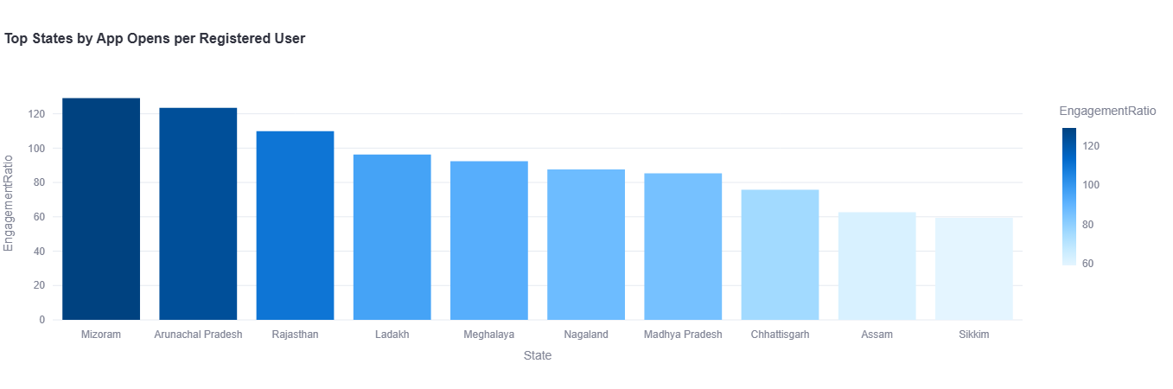
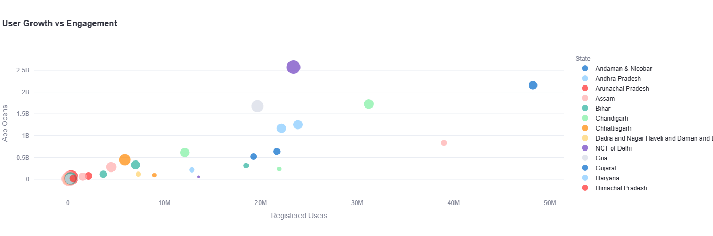
Visualisation
App Opens to Registered Users Ratio
Growth Strategy: Users vs Engagement

Slide 15
Summary
Phone pe transaction insight analyses the transaction trends, user behaviour, and regional usage patterns on Phone Pe.
Steady increase in digital transactions, especially in Tier 2 and Tier 3 cities
Karnataka, Maharashtra, and Uttar Pradesh show highest transaction volumes.
Mobile recharges, utility bill payments, and peer-to-peer transfers dominate.

Slide 16
Thank You

